Slide 1

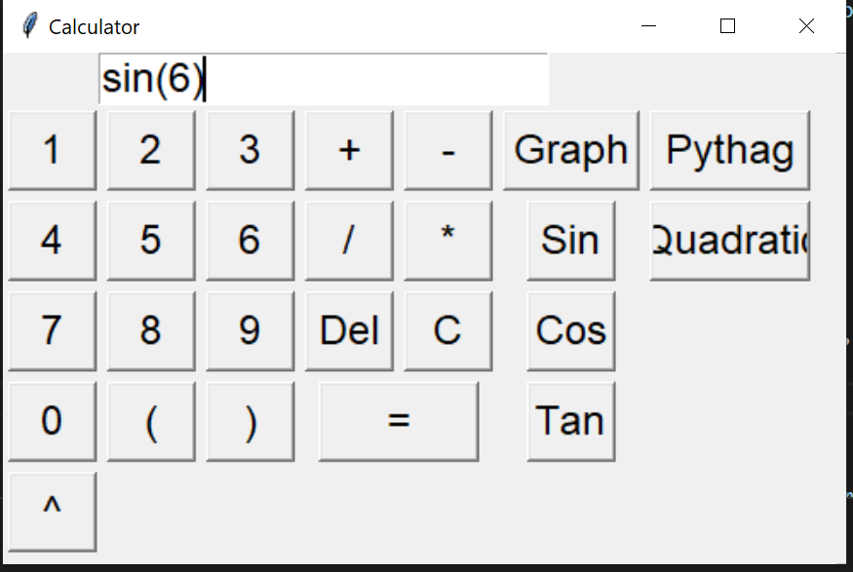
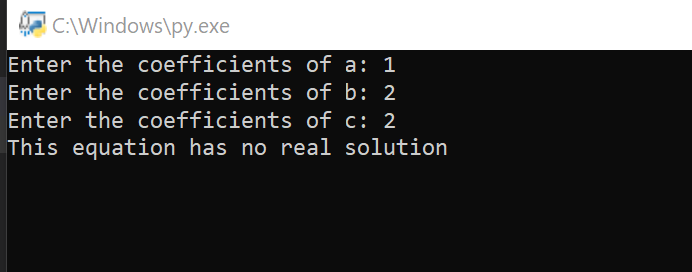
Advanced Multifunction Calculator
A Calculator with simple mathematical functions as well as more advanced formula solvers and unit conversion capabilities
Created By Zach Sapp and Adam Rath
Simple Calculator Function
Quadratic Formula Solver

